Slide 1
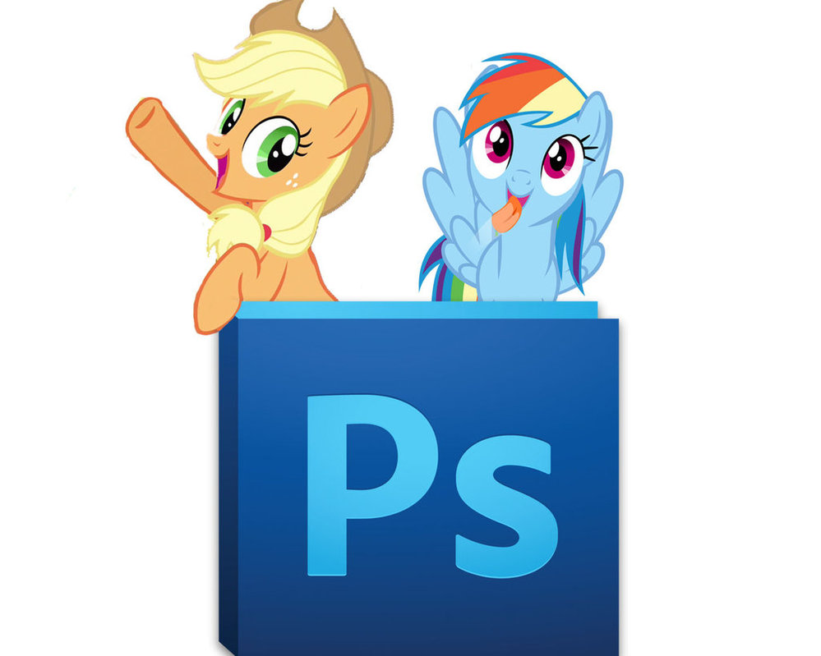
Working with Tools

Slide 2
Introduction to Tools
Tools are used for creating and editing images, artwork, page elements, and so on.
Related tools are grouped together.

Slide 3
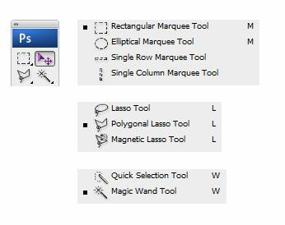
Shape- Based Selection Tools
Marquee Tool
Lasso Tool
Quick Selection and Magic Wand Tool

Slide 4
Marquee Tool(M)
The marquee tools let you select rectangles, ellipses, and 1‑pixel rows and columns.
  Rectangle Marquee Tool
  Elliptical Marquee Tool
  Single Row Marquee
  Single Column Marquee

Slide 5
Main Points while using Marquee Tool
Press ALT Key while using Move command . It now appears with two triangles. Move the selection and pixels will be copied and pasted into new location
Make a selection where you want to paste the pixels and click on Edit- Paste Into
You can fill foreground color in the selection using Alt+Del key. We kept green for foreground.

Slide 6

Exploring the options bar for Marquee Tools
New selection
Add to selection
Subtract from selection
Intersect

Slide 7
More Options:
Feather – Creates soft-feathered edge around a selection and rounded corners.
Style Options
  Normal
  Fixed ratio
  Fixed size

Slide 8
Some More Shortcuts
Selection – Shift
Remove selection- Alt
Switch between tabs: Ctrl+Tab

Slide 9
LASSO TOOL (L)
Lasso Tool – Free-Form Selection
Polygonal Lasso Tool – Makes Straight Edged Selections
Magnetic Lasso Tool – Behaves Like a Magnet

Slide 10
Magnetic Lasso Tool Options
Width: It allows you to specify the distance from within the tool detects edges. For example- if you enter 10 in the width , the tool selects pixels that are within a distance of 10 pixels from the cursor.
      Contrast: It determines how much difference should be there in the object to be selected and the background of the object.
Frequency: It determines the number of anchor points during selection (0 TO 100)

Slide 11
Quick Selection Tool(W)
It provides an easy way to make a selection by painting over the desired area in or image.
    New selection
    Add to selection
    Subtract from selection
    Auto-enhance: will enhance the quality of selections, but recommended only to a computer having good configurations.

Slide 12
Magic Wand Tool
The Magic Wand Tool is one of the oldest selection tools in Photoshop.
Unlike other selection tools that select pixels in an image based on shapes or by detecting object edges, the Magic Wand selects pixels based on tone and color.
Shortcut Key as “W”

Slide 13
Magic Wand Selection(W)
It is used to select the adjacent areas of the same color in an image.
      Add to selection and all
      Tolerance: By default, the Tolerance value is set to 32, which means that Photoshop will select any pixels that are the same color as the area we clicked on, plus any pixels that are up to 32 shades darker or 32 shades brighter
      Contiguous: Selects the adjacent regions of color. If you want to select similar but not adjacent then keep this option turned off.
      Anti aliasing: means smoothing the edges by applying some blur on them.

Slide 14
Crop tool(C)
  The Crop tool allows you to select an area of an image and discard everything outside this area.
  Options:
    Shield: will enable or disable the
    Color: color of the area beyond selection.
    Opacity: opacity of the area beyond selection.
    Perspective:

Slide 15
EyeDropper Tool(I)
Takes color samples from colors on the page and displays them in the Color Boxes.
Setting the Color by using EyeDropper:
Place the mouse-pointer on the area of the image from where you want to take the sample
Press the ALT key and keeping the key pressed, click the mouse button

Slide 16

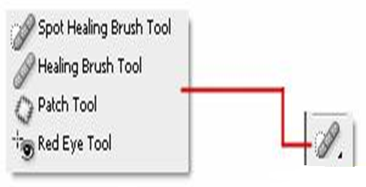
These tools repair damaged images, apply repeated patterns, or replace colors in an image.

Slide 17
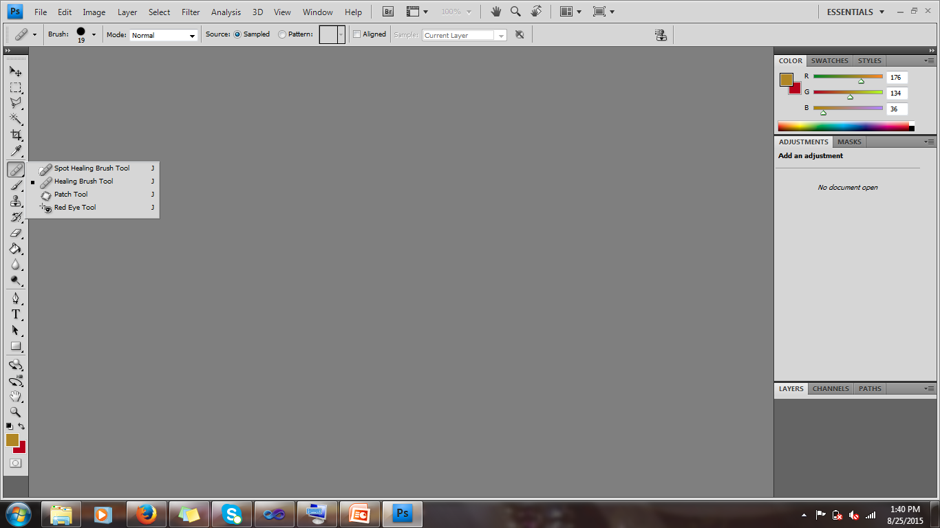
Spot Healing Brush Tool(J)
The Spot Healing Brush is primarily used to quickly remove blemishes, imperfections or other unwanted elements from an image.
To use it, paint over an imperfection you’d like to get rid of using a suitable brush (brushes can be selected and modified in the options bar).
Unlike the Healing Brush, the Spot Healing Brush doesn’t require you to specify a sample spot. The Spot Healing Brush automatically samples from around the retouched area.

Slide 18
Options of Spot Healing Brush Tool
Choose a Type option in the options bar:
Proximity Match
  Uses pixels around the edge of the selection to find an area to use as a patch.
Create Texture
  The Create Texture brush type may work better if the area being retouched has a texture.
  This brush type samples all of the pixels inside the brush, not just the ones near the edge, in order to recreate the original texture.
  Uses pixels in the selection to create a texture. If the texture doesn’t work, try dragging through the area a second time.

Slide 19
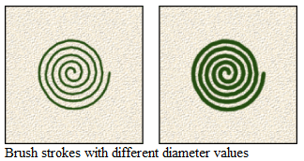
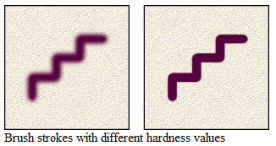
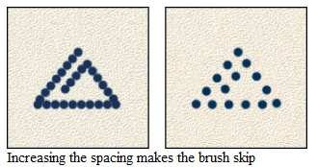
More Options of Brush
Diameter : Controls the size of the brush. Enter a value in pixels or drag the slider.
Hardness : Controls the size of the brush's hard center.
Spacing : Controls the distance between the brush marks in a stroke.

Slide 20
More …
Mode : Replace leaves the edges of the retouched area naturally jagged in contrast to the smooth edges left by the Healing Brush tools.
The Spot Healing Brush works by guessing colors and textures around the area for replacement and fills it automatically without the need to sample a source location.
The Spot Healing Brush works well for minor blemishes in areas where surrounding texture is fairly consistent like the cheeks, chin or forehead.

Slide 21
Healing Brush Tool
The Healing Brush Tool performs a similar function to the spot healing brush tool mentioned above.
Instead of automatically trying to determine the lighting, shading, and texture from the surrounding area, the healing brush tool lets you manually select a source, and then paint over an imperfection.
To select a source, hold alt and click the desired part of the image. Then paint over the area you wish to replace.
As with the Spot Healing Brush Tool, settings such as brush size can be controlled in the options bar.

Slide 22
Source: Sampled
To retouch areas with one hand-picked sample, In the Source section, select Sampled
To select the sample that will cover the areas to be retouched, press [Alt] + click the area to copy
To cover a portion of the image with the copied portion, drag or click the mouse
HINT: Dragging the brush will begin to "repaint" the entire original image, beginning with the selected sample point.

Slide 23
Source: Pattern
To retouch the image with a pattern, In the Source section, select Pattern
From the drop-down Pattern Picker, select a pattern
To cover a portion of the image with the pattern, drag or click the mouse on the desired area.

Slide 24
More ..
The Healing Brush is an interpretive tool, in that it separates the source and destination into text, luminosity and color to blend the source and destination together into a more seamless result than what Clone Stamp tool might provide.
The Healing Brush is good for fixing facial blemishes or lines under the eyes.

Slide 25
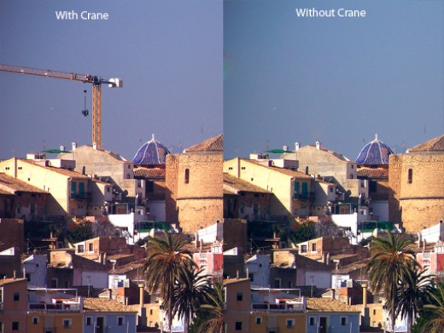
Patch Tool
With the Patch Tool, an entire area can be repaired with pixels from another area.
Just like the healing brush tool, the patch tool will try to correct lighting, shading, and texture.

Slide 26
By Using Patch as Source
Method 1:
  In the Toolbox, select the Patch Tool.
  Drag in (select) a damaged area with the Patch Tool**(exactly like with Lasso Tool)
  On the Options bar, choose the Source mode.
  Drag the selection (cursor inside the selection) onto a repair-source area (movie).

Slide 27
By Using Patch as Destination
Method 2:
  Drag in a repair-source area with the Patch Tool*.
  On the Options bar, choose the Destination mode.
  Drag the selection (cursor inside of selection) onto a damaged area (movie).

Slide 28
Red Eye Tool
The Red Eye tool looks for red, so it isn't of any help if you want to correct green or white eye.
Pupil Size: Increase or Decrease the area affected by the Red Eye Tool.
Darken Amount: Increase or Decrease the darkness of the correction.

